Slide 1
TOWNSHIP HIGH SCHOOL DISTRICT 113
Adult Education Newsletter
October 2023
There are a LOT of exciting Job Center events coming up in the next few weeks. Please participate and share with anyone who would benefit from these events.
We’ll be at four sites during the next quarter for Job Center on the Move.
The October calendar begins with a new workshop called “Overcoming Barriers” and ends with an
informational workshop in honor of manufacturing month.
We have two job fairs coming up. Hire Lake County takes place tomorrow in Lincolnshire and will feature
over 100 employers! We are also co-hosting a job fair at the Zion-Benton Public Library on October
18th. 20 employers are expected to attend!
Job Center kiosks are now installed at the Waukegan Public Library and the CLC Lakeshore campus. The
purpose of kiosks is to expand access to Job Center services to the community. Join us for an open house
at either host site this month.
Workforce Development is recruiting for a Work, Earn, and Learn (WEL) program at Baxter Credit Union.
CLC is holding an open house at the Advanced Technology Center in Gurnee on October 25
The Job Center of Lake County is your Career Solution! Our mission is to cultivate and connect our employers and workforce to fuel economic growth and well-being in Lake County. Download the October monthly event calendar(PDF). It's manufacturing month. View featured events!
The Job Center of Lake County will be closed to the public on Monday, October 9, 2023.
You still have time to attend the 3rd Annual Hire Lake County Job Fair on Tuesday, September 26, 2023 from 11:00 am - 1:30 pm at Lincolnshire Marriott, Ten Marriott Dr, Lincolnshire, IL 60069. Early access to veterans starting at 10:30 am. Register for this event. Download the flyer (PDF.)
Manufacturing Month Featured Events
Wednesday, October 11, 2023 from 11:00 am - 1:00 pm Manufacturing Internship & Career Fair - Student Street at Grayslake Campus 19351 West Washington Street, Grayslake, IL 60030 This annual event provides opportunities for employers and job seekers to connect. It is ideal for individuals looking to begin or advance their manufacturing careers and companies who are seeking interns or apprentices in the skilled trades. View employer and job seeker registration information.
Wednesday, October 25, 2023 from 5:00 pm - 7:00 pm Manufacturing, Engineering, & Advanced Technologies Open House Advanced Technology Center, 7735 W. Grand Ave, Gurnee, IL 60031 Whether you're looking to start your career journey, change careers, want to learn more about manufacturing, or just check out the Advanced Technology Center, come out to our open house! To learn more about this event download the flyer.
Thursday, October 26, 2023 from 11:00 am - 12:00 pm Manufacturing Career Pathways: Training and Employment Options The manufacturing industry needs you! Learn about training options that will help set you on a career path in advanced manufacturing. Whether you’re starting or changing your career, this workshop will provide you with valuable insights. Register to attend in-person or online.

Slide 2
Page 2
Recruitment and Job Fair
Wednesday, October 18, 2023 from 1:00 pm - 3:00 pm Zion Job Fair Zion-Benton Public Library, 2400 Gabriel Avenue, Zion, IL 60099 The Job Center of Lake County is co-hosting a job fair at the Zion-Benton Public Library. Meet with 20 employers from a variety of industries including: manufacturing, transportation, professional services, and much more! Bring copies of your resume. Download flyer (PDF).
Work, Earn, & Learn
The WEL program is offering a NEW opportunity to participate in a hands-on internship with BCU. We have limited spots available.
Launch your career with industry professionals
Work full-time for six months in a paid internship ($18/hr.)
Eligible for industry-recognized credentials
Take the first step towards your future and submit an interest form. Download flyer (PDF).
Workshops
The following workshops are available online or can be attended onsite at the Job Center of Lake County at 1 N. Genesee St., Waukegan, IL 60085.
Tuesday, October 3, 2023 from 1:00 pm - 2:00 pm Overcoming Barriers Overcome barriers to employment due to being justice impacted. This workshop will provide you with information to help you gain the confidence and skills necessary to succeed in the workforce. Learn about resources and tools to help you jumpstart your job search, such as expungements, sealings, professional license, and driver’s license reinstatement, education, employment, and training services. Register to attend in-person or online.
Tuesday, October 10, 2023 from 1:00 pm - 2:00 pm Accelerate Your Job Search Are you seeking a job or changing careers? Regardless of your job title or field, you have a personal brand. Learn how to customize your resume and other written tools to help you land a great job! Register to attend in-person or online.
Tuesday, October 17, 2023 from 1:00 pm - 2:00 pm
Your Personal Brand & Resumes Are you seeking a job or changing careers? Regardless of your job title or field, you have a personal brand. Learn how to customize your resume and other written tools to help you land a great job! Register to attend in-person or online.
Tuesday, October 24, 2023, from 1:00 pm - 2:00 pm
Master the Interview Are you applying for a new job, pursuing a promotion, or looking for a career change? The Master the Interview workshop will equip you with the tools and knowledge needed to succeed in any interview. You'll learn effective strategies for preparing and providing safe answers, tips for leaving a lasting impression, and how to prepare for a virtual or in-person interview. Register to attend in-person or online.
Other Locations:
Thursday, October 5 & 12, 2023 from 10:00 am to 12:00 pm Zion-Benton Public Library 2400 Gabriel Ave., Zion, IL 60099
Tuesday, October 10, 2023 from 10:00 am to 12:00 pm Catholic Charities 101 N. Cedar Lake Rd., Round Lake, IL 60073
Thursday, October 12, 2023 from 11:00 am to 1:00 pm North Chicago Public Library 2100 Argonne Dr, North Chicago, IL 60064 *Employers onsite ready to hire
Tuesday, October 17, 2023 from 11:00 am to 1:00 pm Legacy Reentry Foundation 420 W. Clayton St., Waukegan, IL 60085 *Employers onsite ready to hire

Slide 3
https://www.jotform.com/form/231555769629168

Slide 4
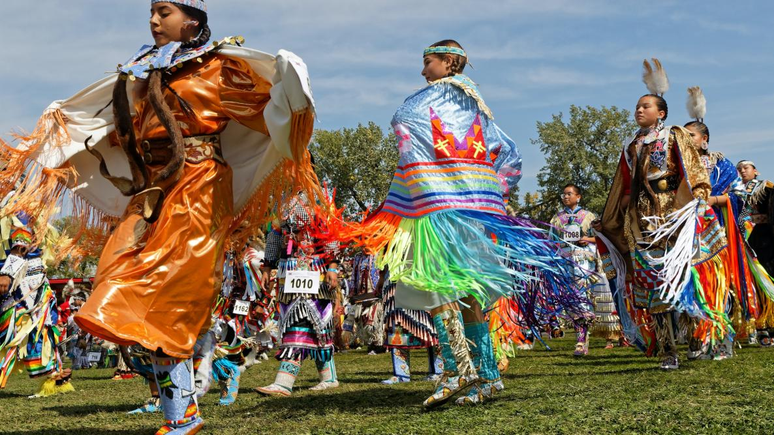
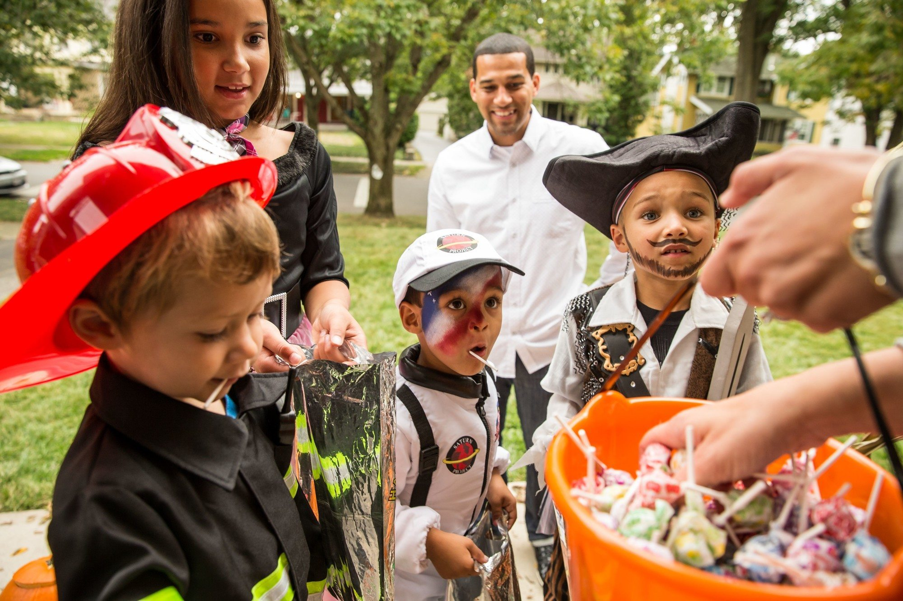
Page 4
Job Center on the Move
Meet with a Job Center representative one-on-one to work on the next steps in your career. Choose from a menu of custom services when you register!
* Discuss your career transition * Develop or customize your resume * Connect with funding for training + Explore paid work experience (internship) options * Learn about growing businesses in your area
*Download the Job Center on the Move flyer - Oct - Dec 2023 (PDF)
Lake County Workforce Development Phone: 847-377-3442 Email: rgrant@lakecountyil.gov
Current Workshops
Link for current workshops
https://www.lakecountyil.gov/393/Calendars
The Job Center of Lake County is an equal opportunity employer/program. Find a complete list of accommodations or make a request: https://bit.ly/3EUjr6p. Funds for this project were provided by the U.S. Department of Labor’s (USDOL) Employment and Training Administration. See our website for details. https://bit.ly/3EUjr6p
Celebrated on Monday, October 9, 2023
What Is Indigenous Peoples’ Day?
Indigenous Peoples’ Day honors the histories, cultures, and perspectives of Indigenous peoples and their ancestors who lived on the land now known as North America. They existed in these areas for thousands of years before the first European explorers arrived.
Indigenous Peoples' Day 2023: A Celebration of Culture and History | The Old Farmer's Almanac
Click on the link for the story! >
Celebrated on Tuesday, October 31, 2023
Why Do We Celebrate Halloween?
History of Trick-Or-Treating
Borrowing from European traditions, Americans began to dress up in costumes and go house to house asking for food or money, a practice that eventually became today’s “trick-or-treat” tradition. Young women believed that … See more
*** For more information or if you have any questions, please contact one of the
District 113 Adult Guidance/Transition Coordinators ***
Diego Albarran
Admin. Assistant
(English/Spanish)
Phone: 224-765-2410
Email: dalbarran@dist113.org
Veronica Albarran
(English/Spanish)
Phone: 224-384-7288
Email: aramirez@dist113.org
Suzanne Klauke
Phone: 224-765-2410 and
Email: sklauke@dist113.org

